Slide 1
Module 5 Machine Learning
Michael Noel
Flatiron School
11/12/2019

Slide 2
Business Case
Doing marketing to people who are your target audience is a key of marketing. This could save a business tens of thousands of dollars per year. I am finding how to sort people by whether or not they make more than $50,000 in income per year. This will save higher end businesses from wasting their marketing money on people who can not afford their products.

Slide 3
Data that I used
I used data from the 1996 census
This is public data

Slide 4
How I got my results
I was able to get 87% accuracy by using a method called random forest.
Random forests make splits in a certain feature such as age in order to split the people into 2 categories as best as possible.
For example if everyone under 40 made less than $50,000 then the random forest would split on age 40 in order to know which people are making more than $50,000 per year.

Slide 5
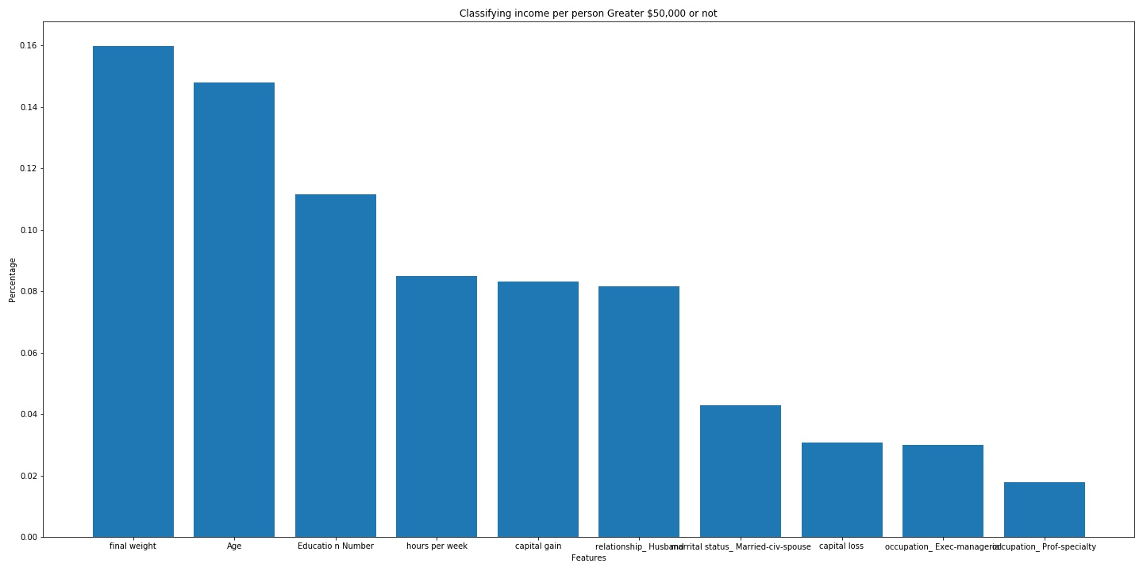
The relative importance of the top features

Slide 6
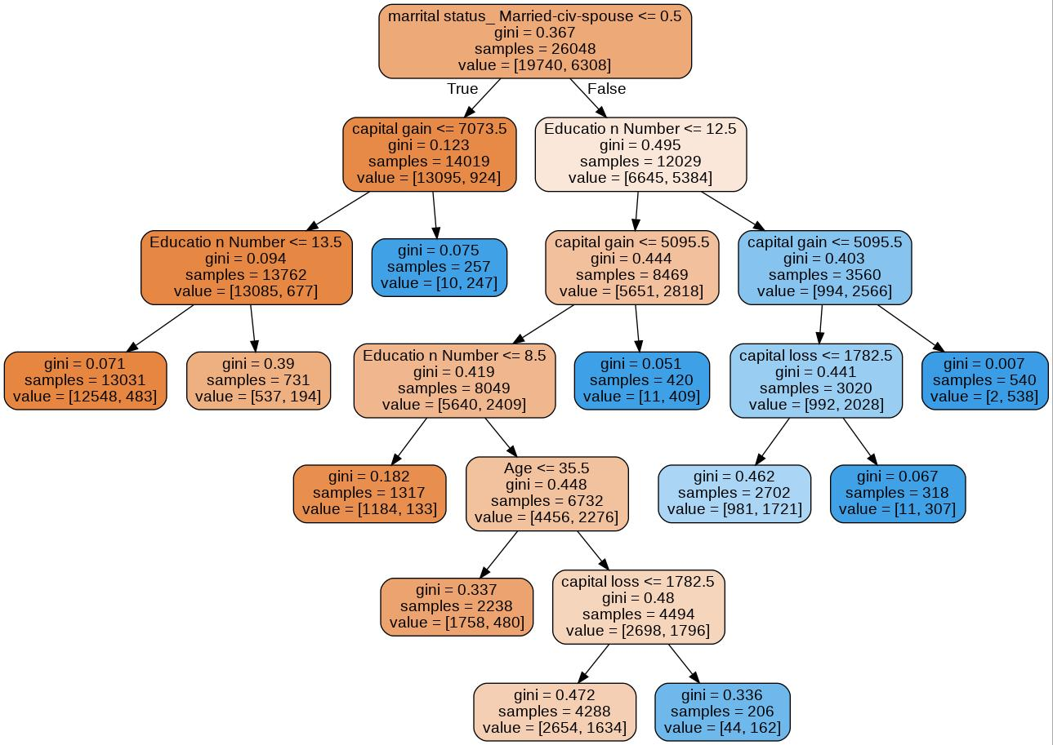
Top Splits in a Decision Tree Blue >$50,000 Orange < $50,000

Slide 7
Reccomendations
I would collect data on customers on age,education, and whether they are married or not. These are easy to get and near the top most important features.
I would send marketing to housing areas with strong averages near the splits that have people who make more than $50,000.
I would only have stores in areas with lots of people who have high enough levels of the most important features. This way the business has a chance of staying in business.

Slide 8
Future Work
I could try to run other type of models with other parameters to try and increase accuracy.
I could find data from the census that has more features such as location, has kids or not, and other important features.
Figure out which income bracket is the most important for making and keeping customers.

Slide 9
Thanks for looking at my presentation

